Slide 1
Introduction to NumPy
NUMPY

Slide 2
Introduction to Numpy
What is Numpy?
Creating Numpy Arrays.
Basic of Numpy Arrays.
Computation on NumPy Arrays.
Aggregations: Min, Max, and Everything in Between.
Comparisons, Masks, and Boolean Logic.
Sorting Arrays.

Slide 3
What is Numpy?
Numpy: Numerical Python
The NumPy library is the core library for scientific computing in Python.
It provides a high-performance multidimensional array object, and tools for working with these arrays.
…

Slide 4
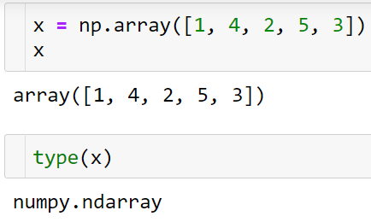
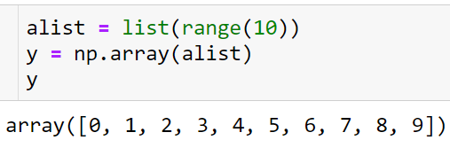
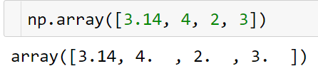
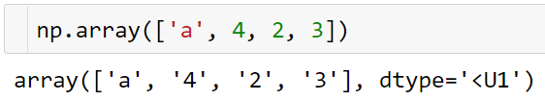
Creating Numpy Arrays
Creating Arrays from Python Lists
Note: Remember that unlike Python lists, NumPy is constrained to arrays that all contain the same type

Slide 5
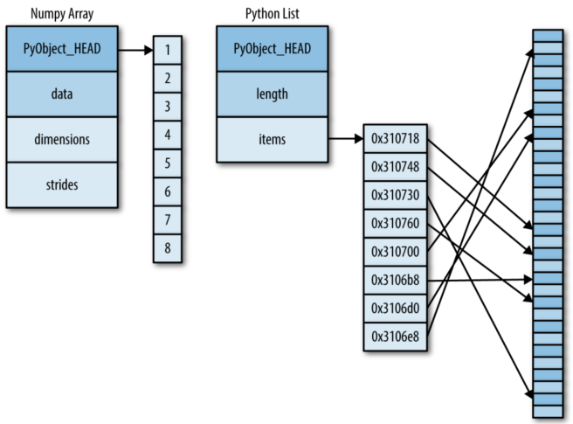
Creating Numpy Arrays

Slide 6
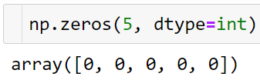
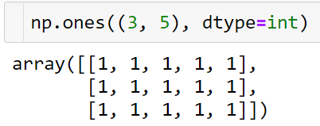
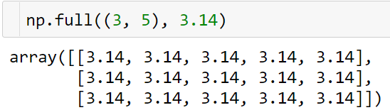
Creating Numpy Arrays
Creating Arrays from Scratch
np.zeros(shape, dtype=float, order =‘C’)
Return a new array of given shape and type, filled with zeros
np.ones(shape, dtype=None, order =‘C’)
Return a new array of given shape and type, filled with ones
np.full(shape, fill_value, dtype=None, order='C’)
Return a new array of given shape and type, filled with fill_value.

Slide 7
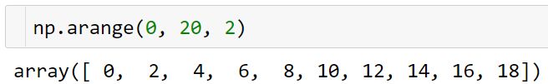
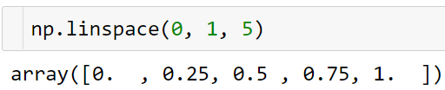
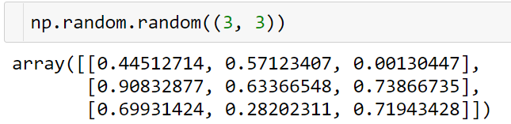
Creating Numpy Arrays
np.arange(start, stop, step, dtype=None):
Return evenly spaced values within a given interval.
np.linspace(start, stop, num=50, endpoint=True, retstep=False,dtype=None, axis=0)
Return evenly spaced numbers over a specified interval.
np.random.random(size=None)
Return random floats in the half-open interval [0.0, 1.0).

Slide 8
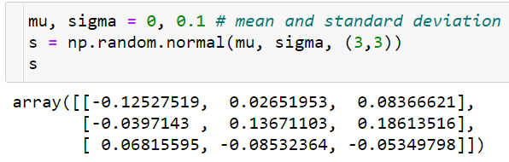
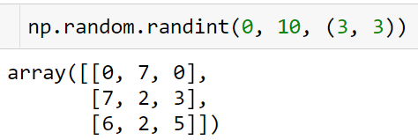
Creating Numpy Arrays
np.random.normal(loc=0.0, scale=1.0, size=None)
Draw random samples from a normal (Gaussian) distribution.
np.random.randint(low, high=None, size=None, dtype=int)
Return random integers from low (inclusive) to high (exclusive).

Slide 9
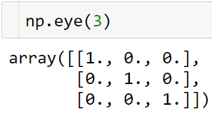
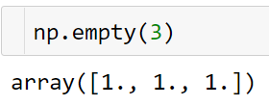
Creating Numpy Arrays
Create a identity matrix:
numpy.empty(shape, dtype=float, order='C')
Return a new array of given shape and type, without initializing entries.

Slide 10
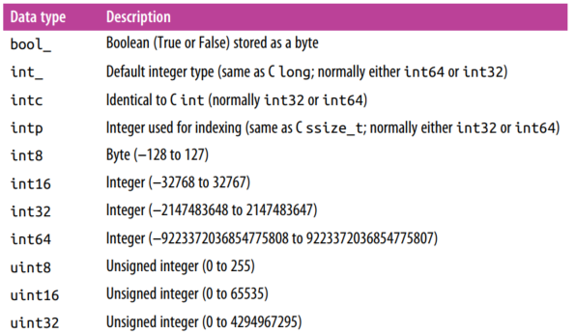
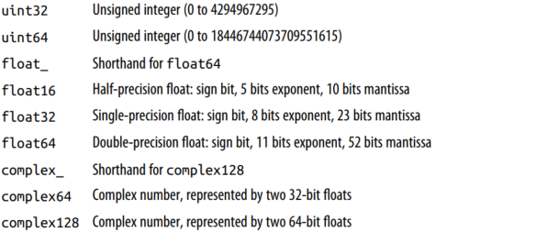
Creating Numpy Arrays
NumPy Standard Data Types

Slide 11
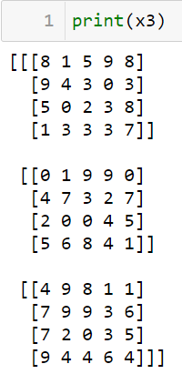
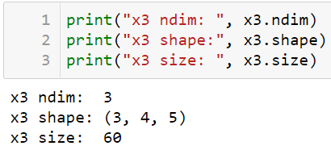
The Basic of NumPy Arrays
NumPy Array Attributes
import numpy as np np.random.seed(0) # seed for reproducibility
x1 = np.random.randint(10, size=6) # One-dimensional array x2 = np.random.randint(10, size=(3, 4)) # Two-dimensional array x3 = np.random.randint(10, size=(3, 4, 5)) # Three-dimensional array
The number of dimensions
The size of each dimension
The total size of the array

Slide 12
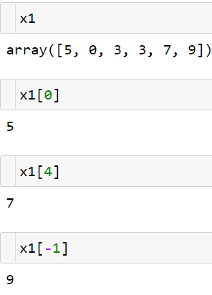
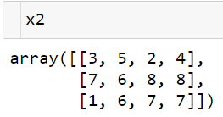
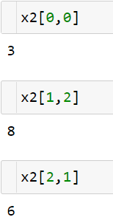
The Basic of NumPy Arrays
Array Indexing: Accessing Single Elements
One-dimensional array: the same as a list
Multidimensional array: using a comma-separated tuple of indices
0
1
2
3
0
1
2
x[row , column]
The first dimensional
The second dimensional

Slide 13
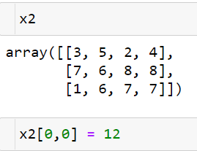
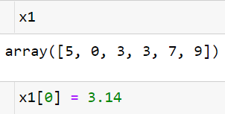
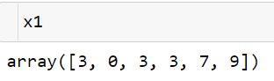
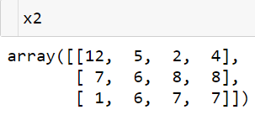
The Basic of NumPy Arrays
Array Indexing: Accessing Single Elements
Modify values using the index notation:
Note: NumPy arrays have a fixed type

Slide 14
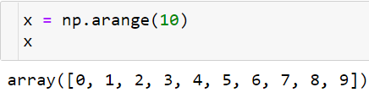
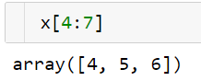
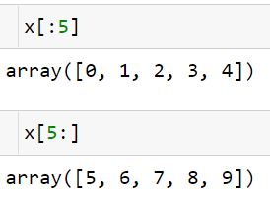
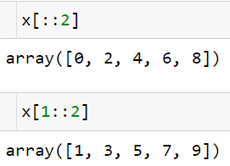
The Basic of NumPy Arrays
Array Slicing: Accessing Subarrays
x[start:stop:step]
One-dimensional subarrays

Slide 15
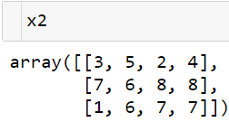
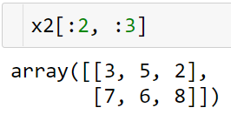
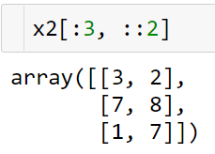
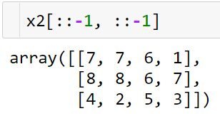
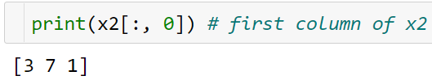
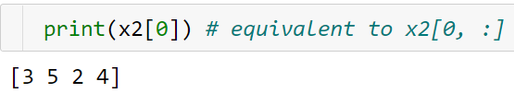
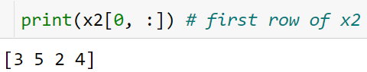
The Basic of NumPy Arrays
Multidimensional subarrays
Accessing array rows and columns

Slide 16
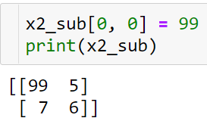
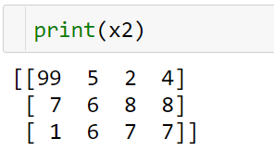
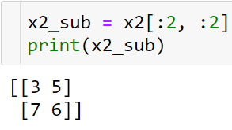
The Basic of NumPy Arrays
Subarrays as no-copy views
Now if we modify this subarray
Note:
One important—and extremely useful—thing to know about array slices is that they return views rather than copies of the array data. This is one area in which NumPy array slicing differs from Python list slicing: in lists, slices will be copies.
This default behavior is actually quite useful: it means that when we work with large datasets, we can access and process pieces of these datasets without the need to copy the underlying data buffer.

Slide 17
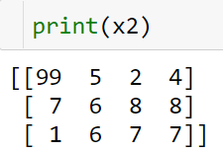
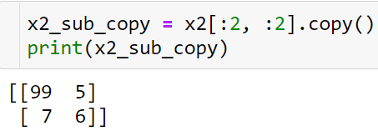
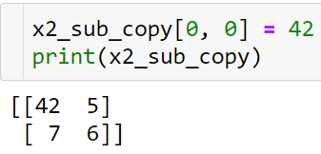
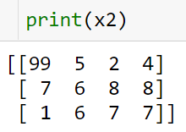
The Basic of NumPy Arrays
Creating copies of arrays

Slide 18
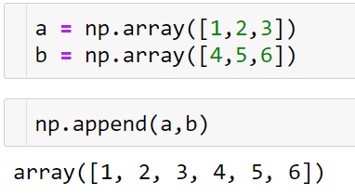
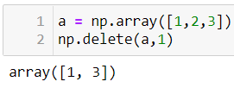
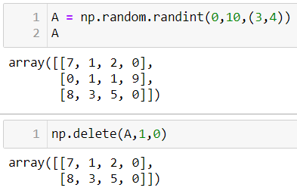
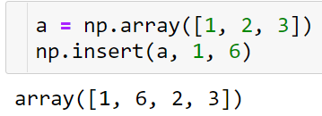
The Basic of NumPy Arrays
np.delete(arr, obj, axis = none)
Return a new array with sub-arrays along an axis deleted. For a one dimensional array, this returns those entries not returned by arr[obj].
Adding – Removing Elements
np.append(arr, values, axis = none)
Append values to the end of an array.
np.insert(arr, obj, values, axis = none)
Insert values along the given axis before the given indices.
Obj: the index or indices

Slide 19
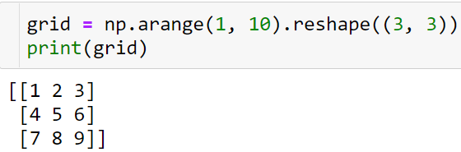
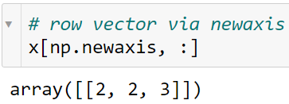




The Basic of NumPy Arrays
Reshaping of Arrays
Note:
The size of the initial array must match the size of the reshaped array.
The reshape method will use a no-copy view of the initial array.
Conversion of a one-dimensional array into a two-dimensional row or column matrix .

Slide 20




The Basic of NumPy Arrays
Array Concatenation and Splitting
Combine multiple arrays into one, and to conversely split a single array into multiple arrays
Concatenation of arrays: np.concatenate.

Slide 21




The Basic of NumPy Arrays
Axis:

Slide 22

The Basic of NumPy Arrays
Axis:

Slide 23




The Basic of NumPy Arrays
Splitting of arrays: np.split
Split an array into multiple sub-arrays vertically (row-wise)
index
Split an array into multiple sub-arrays horizontally (column-wise)
np.vsplit = np.split( ,axis = ?)
np.hsplit = np.split( ,axis = ?)

Slide 24



Computation on NumPy Arrays
Arithmetic Operations
+ : np.add
Add arguments element-wise

Slide 25






Computation on NumPy Arrays
Broadcasting

Slide 26
Computation on NumPy Arrays
Rules of Broadcasting
Rule 1: If the two arrays differ in their number of dimensions, the shape of the one with fewer dimensions is padded with ones on its leading (left) side.
Rule 2: If the shape of the two arrays does not match in any dimension, the array with shape equal to 1 in that dimension is stretched to match the other shape.
Rule 3: If in any dimension the sizes disagree and neither is equal to 1, an error is raised.

Slide 27



Computation on NumPy Arrays
np.exp
Calculate the exponential of all elements in the input array.
np.sin
Trigonometric sine, element-wise.
np.cos
Cosine element-wise..
np.sqrt
Return the non-negative square-root of an array, element-wise.
np.log
Natural logarithm, element-wise.

Slide 28



Computation on NumPy Arrays
np.dot
Dot product of two arrays.

Slide 29





Comparisons, and Boolean Logic
Comparisons

Slide 30




Comparisons, and Boolean Logic
Boolean Indexing
Summing the Values in an Array

Slide 31
Practice
Exercises
Are there any values greater than 8?
Counts the frequency of 3 in x.
The sum of the elements is greater than 3 of x.
Product of odd numbers of x
The Sum of the prime numbers of x
How many values less than 6 in each row?

Slide 32



Aggregations: Min, Max, and Everything in Between
Minimum and Maximum

Slide 33



Aggregations: Min, Max, and Everything in Between

Slide 34








Fancy Indexing
Exploring Fancy Indexing
Fancy indexing is conceptually simple: it means passing an array of indices to access multiple array elements at once.

Slide 35





Fancy Indexing
Combined Indexing
We can combine fancy indexing with masking:

Slide 36




Fancy Indexing
Modifying Values with Fancy Indexing
Where did the 4 go?

Slide 37






Sorting Arrays
np.sort and sort method
Sorting along rows or columns

Slide 38



Sorting Arrays
Sorts: Partitioning
np.partition takes an array and a number K; the result is a new array with the smallest K values to the left of the partition, and the remaining values to the right, in arbitrary order.

Slide 39


Sorting Arrays
np.argsort
Returns the indices that would sort an array.
np.arpartitiongsort
Returns the indices that would sort an array.

